Slide 1
Spatial Embedding of scRNA-seq Data using Reference SRT Coordinates
KRIBB-KOBIC
Jiin Choi
Donggon Cha

Slide 2
SRT and Single-cell Dataset Analysis Plan
Cell/Spot QC
Cell Segmentation
Count Normalization
Feature
Selection
- Empty droplet / multiplet
inference and removal
- Remove low-quality cells
(Generally manual)
- Decontamination of
ambient mRNA
- Bin2cell: 2um bin to cell
groupings based on
segmentation
- Calculate cell-specific
size-factor and division
- Genes with high
between-cell variance
Dimensionality
Reduction
Data Integration
Count Normalization / Feature Selection / Dimensionality Reduction /
Clustering Cells /
Type Assignment
Domain-specific Analysis
Clustering Cells / Type Assignment
- PCA using expression of variable
features
- 2nd reduction for visualization
(UMAP, t-SNE…)
- Graph-based unbiased clustering
- Biological / computational annotation
of cell types
➔ CNV for malignant cells
- Spatial reconstruction /
embedding of single-cell data
- or embedding directly on
Visium HD data
- To increase scalability
- Previous procedures should be repeated for the integrated data
- Domain calculation
- Calculate domain-specific
cell type proportion and
CCI

Slide 3
SRT and Single-cell Dataset Analysis Plan
Cell/Spot QC
Cell Segmentation
Count Normalization
Feature
Selection
- Empty droplet / multiplet
inference and removal
- Remove low-quality cells
(Generally manual)
- Decontamination of
ambient mRNA
- Bin2cell: 2um bin to cell
groupings based on
segmentation
- Calculate cell-specific
size-factor and division
- Genes with high
between-cell variance
Dimensionality
Reduction
Data Integration
Count Normalization / Feature Selection / Dimensionality Reduction /
Clustering Cells /
Type Assignment
Domain-specific Analysis
Clustering Cells / Type Assignment
- PCA using expression of variable
features
- 2nd reduction for visualization
(UMAP, t-SNE…)
- Graph-based unbiased clustering
- Biological / computational annotation
of cell types
➔ CNV for malignant cells
- Spatial reconstruction /
embedding of single-cell data
- or embedding directly on
Visium HD data
- To increase scalability
- Previous procedures should be repeated for the integrated data
- Domain calculation
- Calculate domain-specific
cell type proportion and
CCI

Slide 4
How to Embed scRNAseq Data on xy Coordinate?
Find index of k-NN of query (single-cell) cells from target (ST) sample
Averaging the k-NN’s xy coordinates
Mapping cell identities of ST dataset ➔ Single-cell dataset

Slide 5
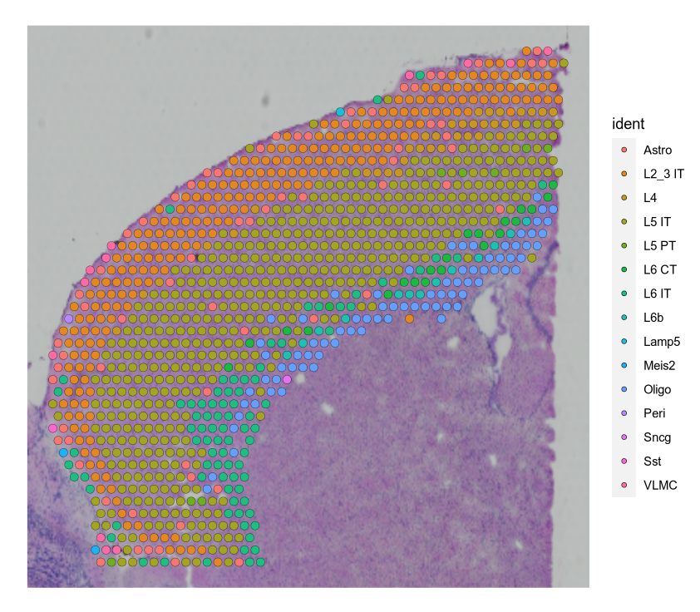
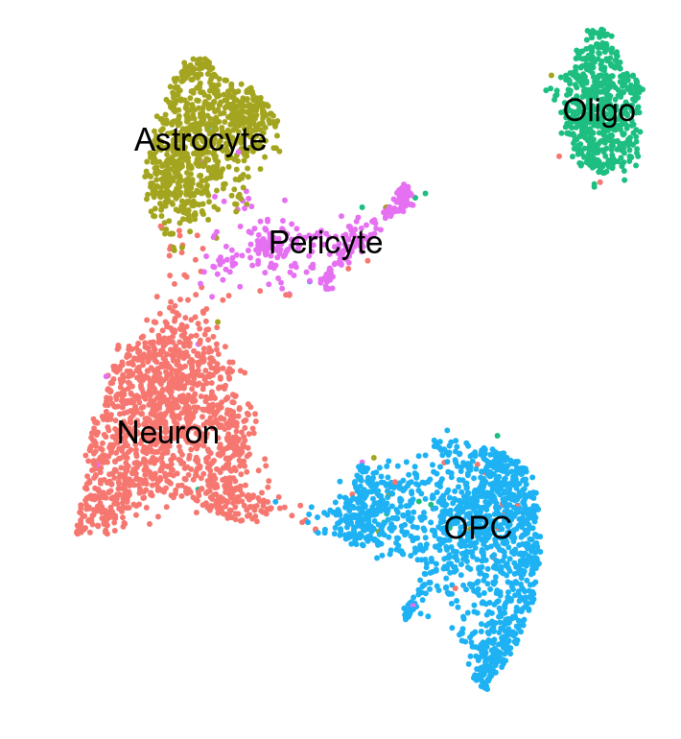
Pilot Study : using Visium V2
Visium V2 Dataset from Mouse Brain
Chromium Dataset from Mouse Brain
1,073 spots
4,621 nuclei
* From Different Region/Tissue

Slide 6
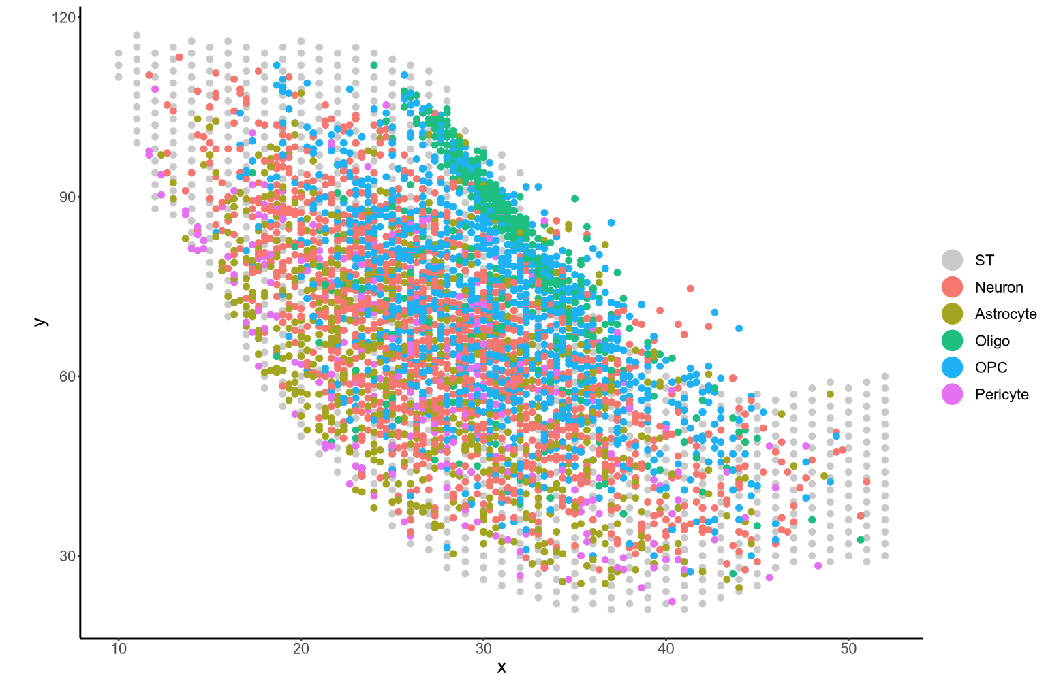
Pilot Study : using Visium V2
Single-nuc Dataset Embedding Result
Visium V2 Dataset from Mouse Brain
Embedding via averaging 3-NN*’s xy coord
1,073 spots
* Calculated using intersection of the HVG lists

Slide 7
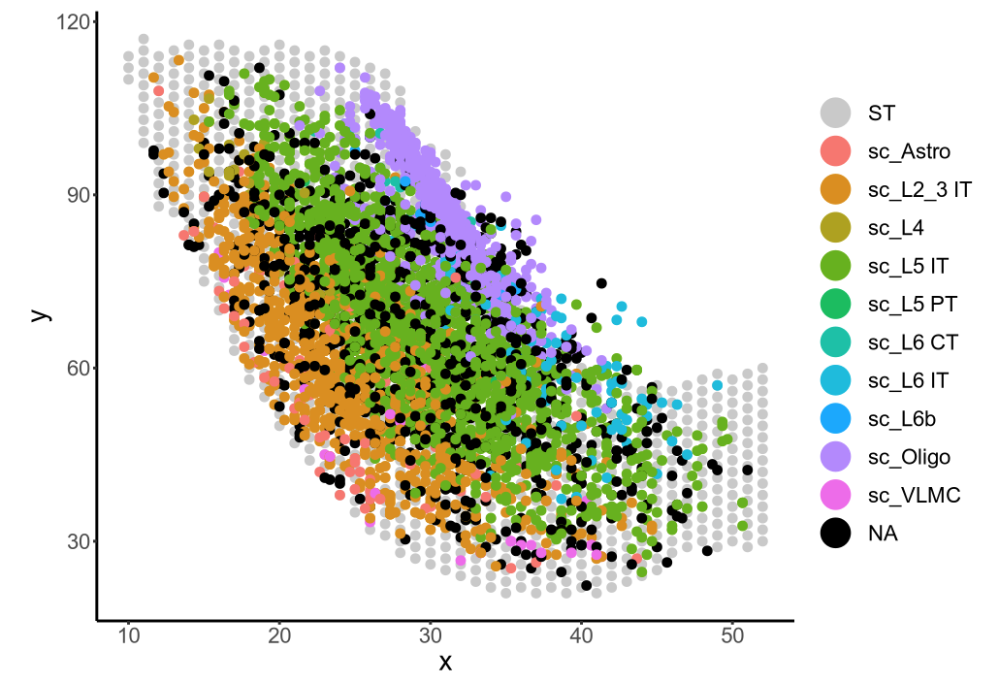
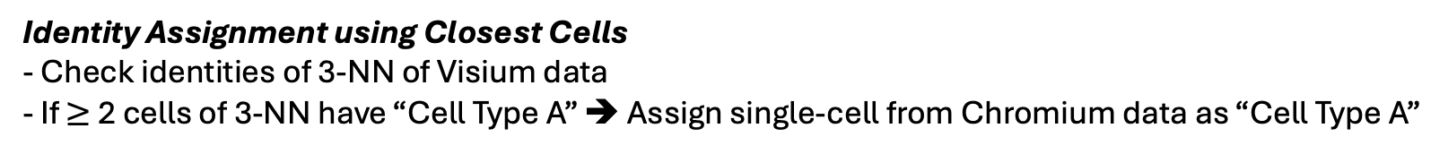
Pilot Study : using Visium V2
Visium V2 Dataset from Mouse Brain
Single-nuc Dataset Embedding Result
Embedding via averaging 3-NN’s xy coord
Oligodendrocytes
Oligodendrocytes
1,073 spots
Identity Assignment using Closest Cells
- Check identities of 3-NN of Visium data
- If $≥$ 2 cells of 3-NN have “Cell Type A” ➔ Assign single-cell from Chromium data as “Cell Type A”

Slide 8
Pilot Study : using Visium V2
Single-nuc Dataset Embedding Result_Mapped_Ident
Single-nuc Dataset Embedding Result_Original_Ident

Slide 9
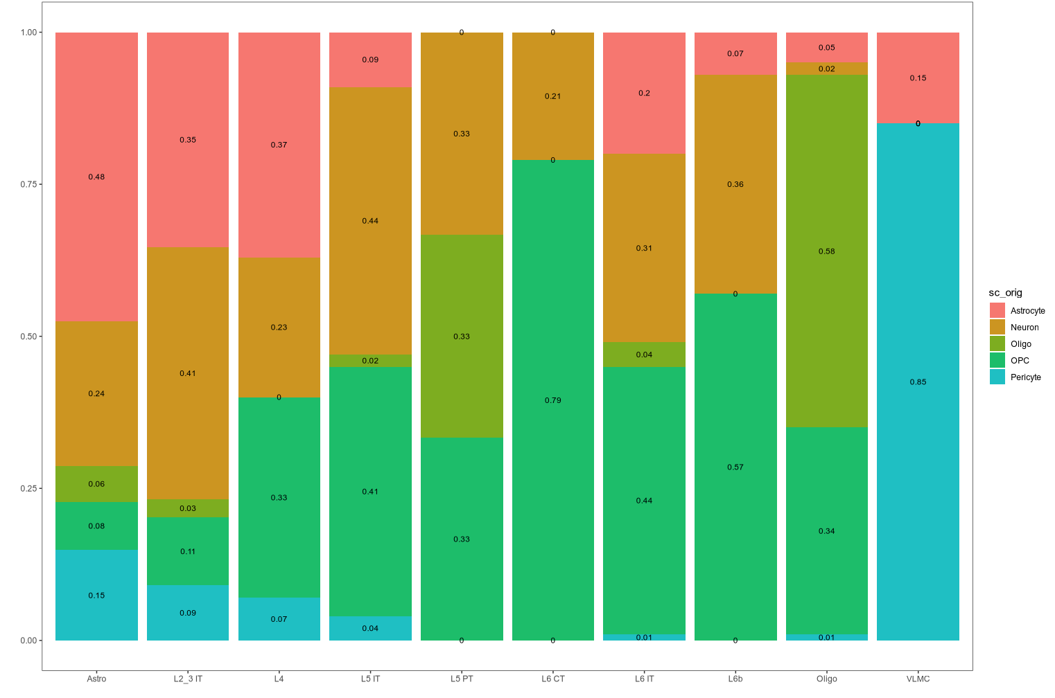
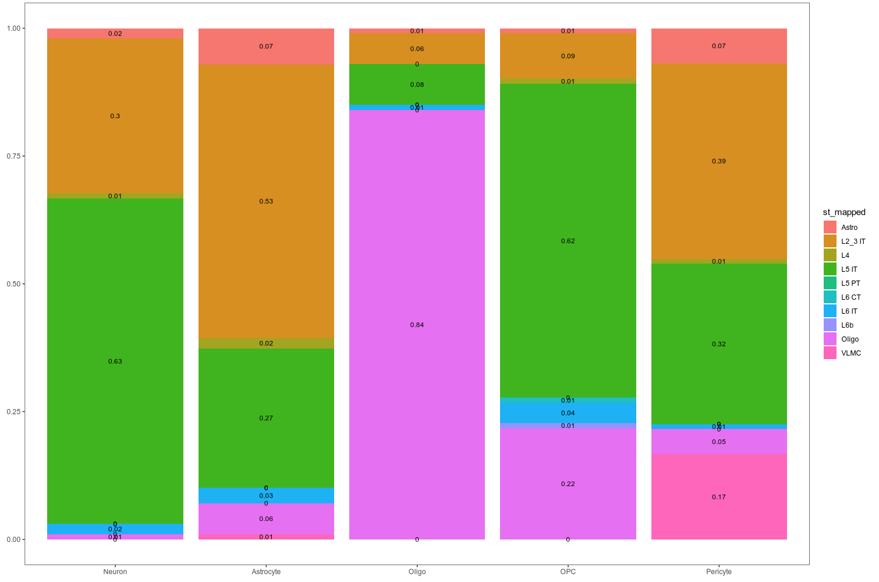
Pilot Study : using Visium V2
ST Cell Type ➔ Single-cell Type Matching Prop
Single-nuc Dataset Embedding Result_Original_Ident
Astro
L4
L5 IT
L5 PT
L6 CT
L6 IT
L6b
Oligo
VLMC
L2_3 IT
Single-cell Type ➔ ST Cell Type Matching Prop
Single-nuc Dataset Embedding Result_Mapped_Ident
Neuron
Astrocyte
Oligo
OPC
Pericyte

Slide 10
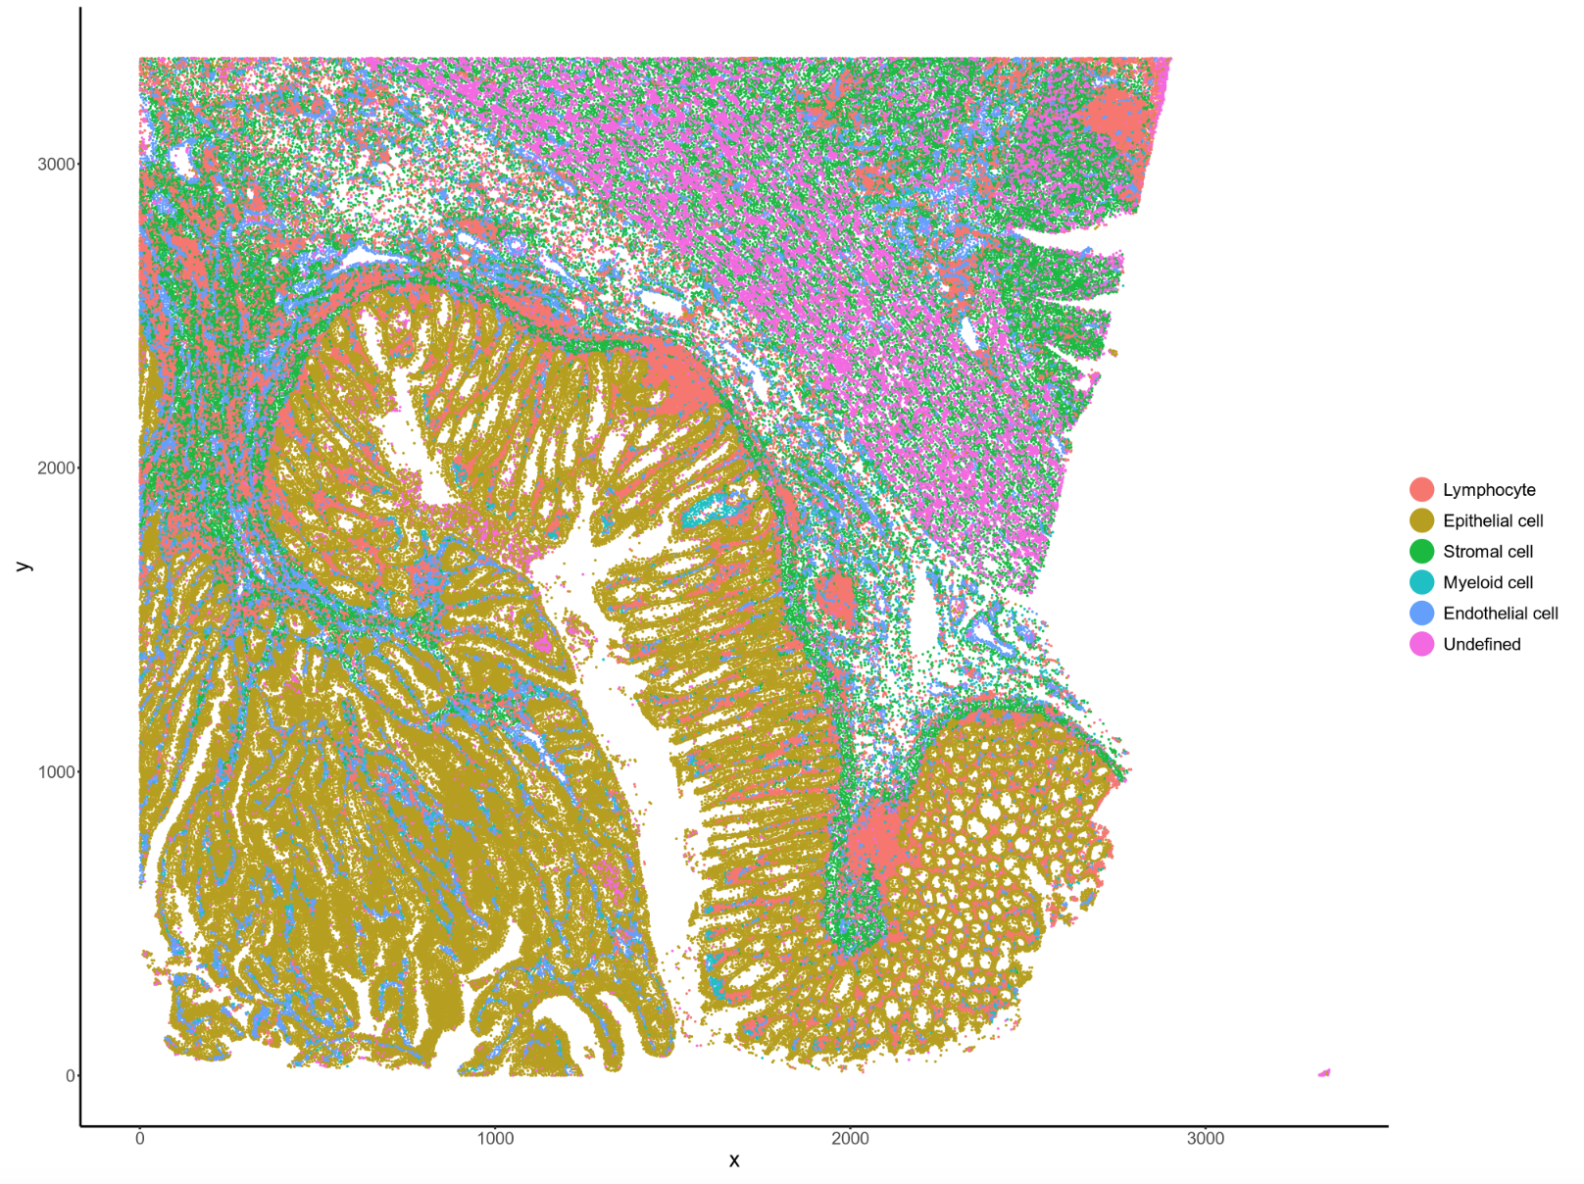
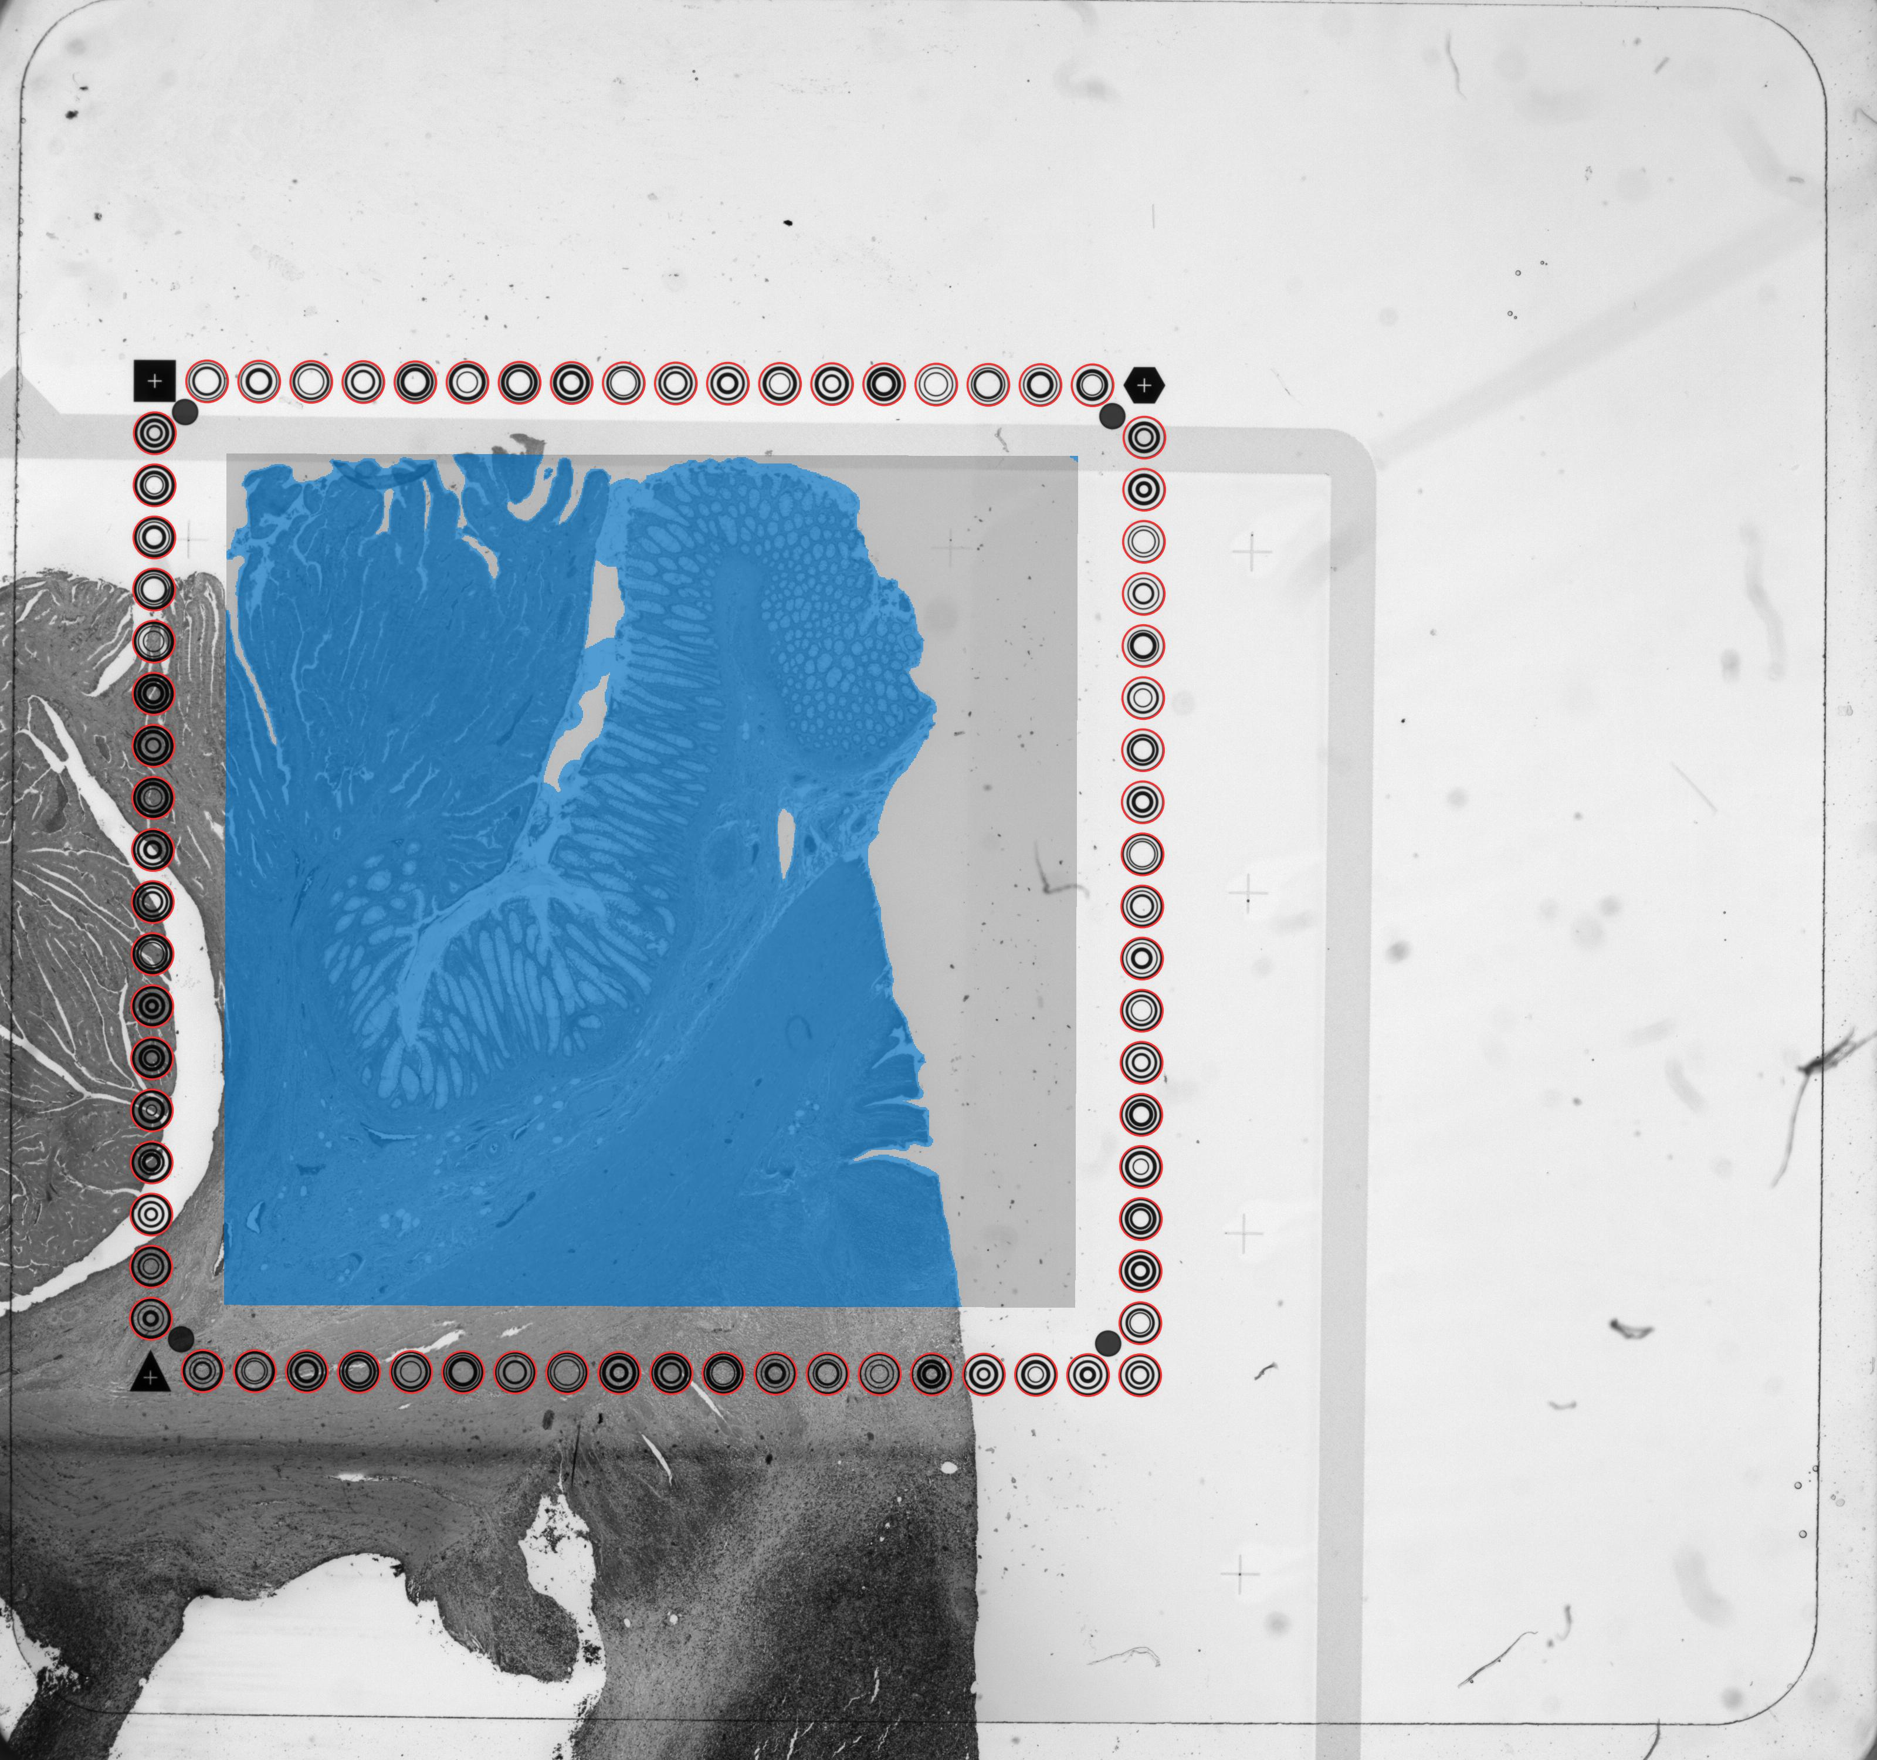
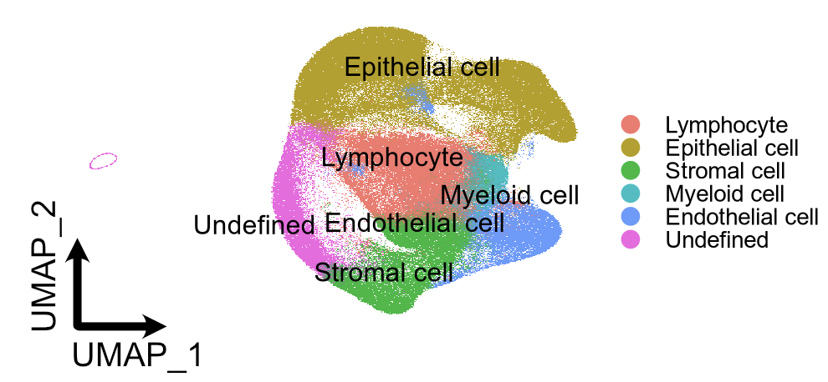
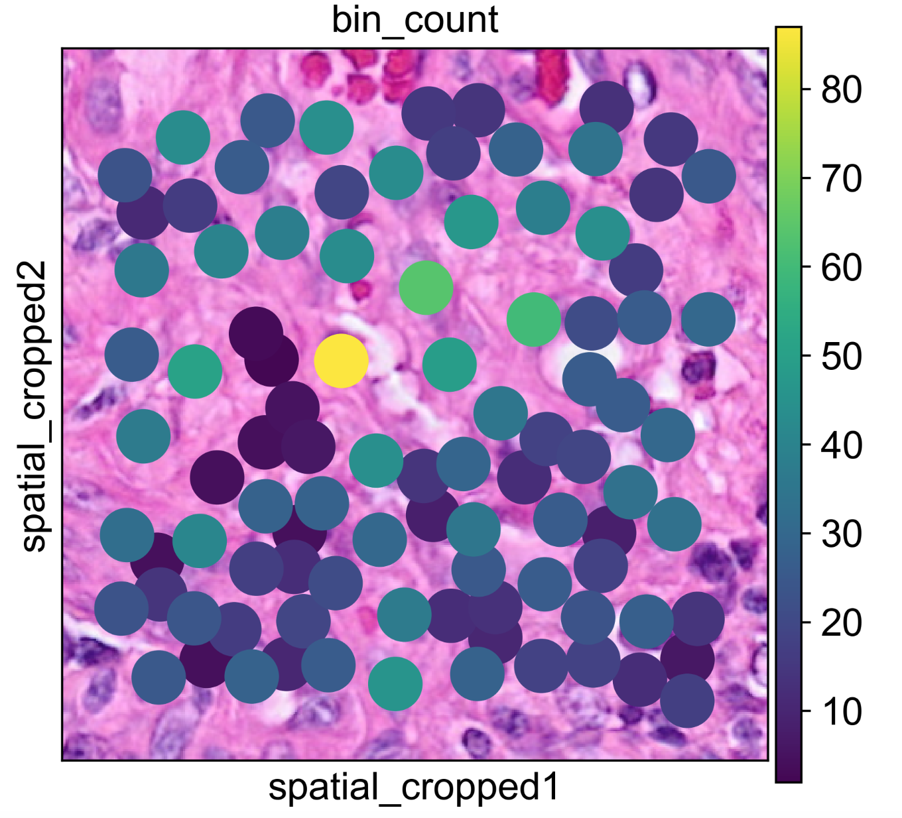
Application on Visium HD Dataset
P5_CRC
bin2cell
Y
X
8,115,564 spots
281,343 cells

Slide 11
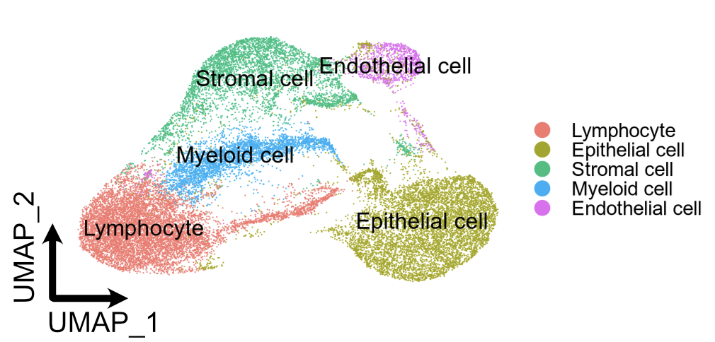
Application on Visium HD Dataset
Visium HD Dataset of P5_CRC
Chromium Single-cell Flex Dataset of P5_CRC
~ 21,000 cells
281,343 cells

Slide 12
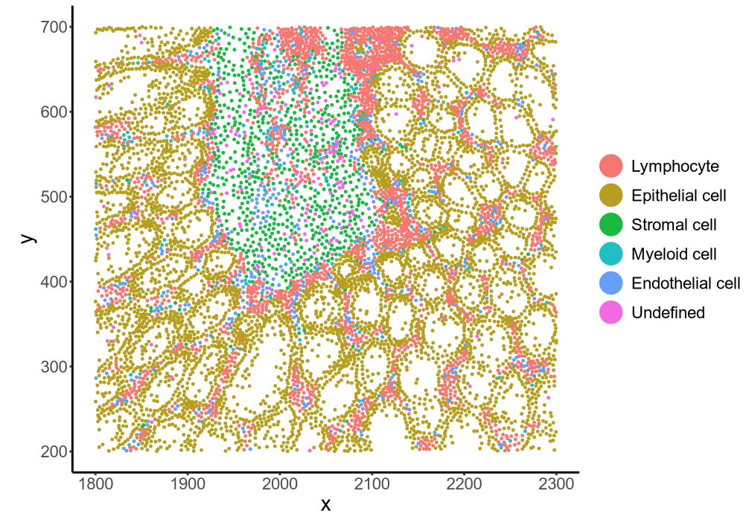
Application on Visium HD Dataset
281,343 cells
9,196 cells

Slide 13
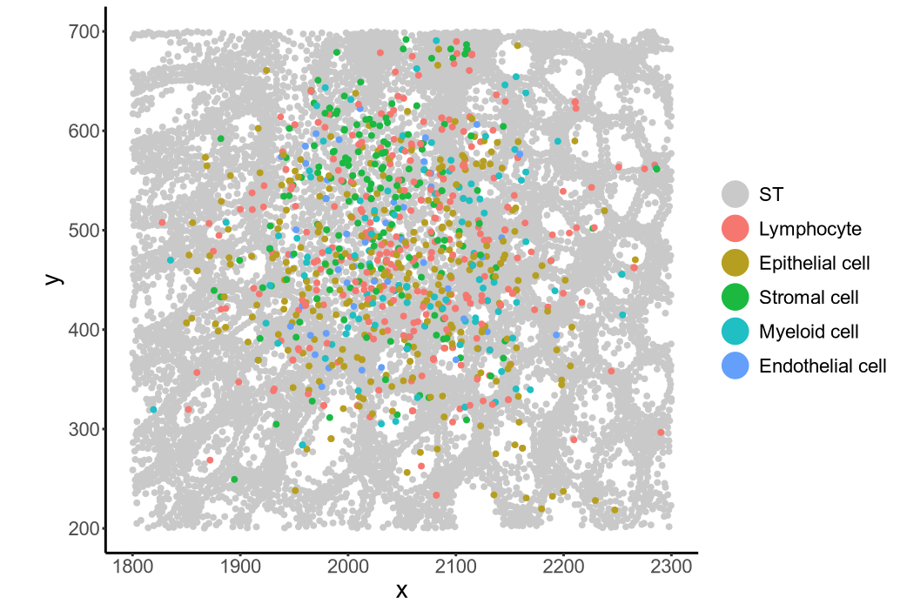
Application on Visium HD Dataset
Visium HD Dataset from P5_CRC
Single-cell Dataset Embedding Result
1,000 Subsampled Cells
9,196 cells

Slide 14
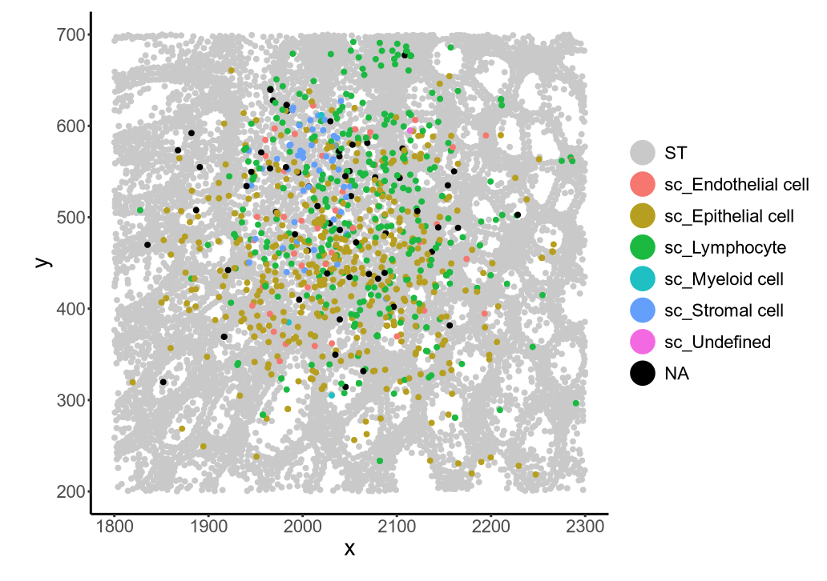
Application on Visium HD Dataset
Visium HD Dataset from P5_CRC
Single-cell Dataset Embedding Result
1,000 Subsampled Cells
9,196 cells
Identity Assignment using Closest Cells
- Check identities of 3-NN of Visium data
- If $≥$ 2 cells of 3-NN have “Cell Type A” ➔ Assign single-cell from Chromium data as “Cell Type A”

Slide 15
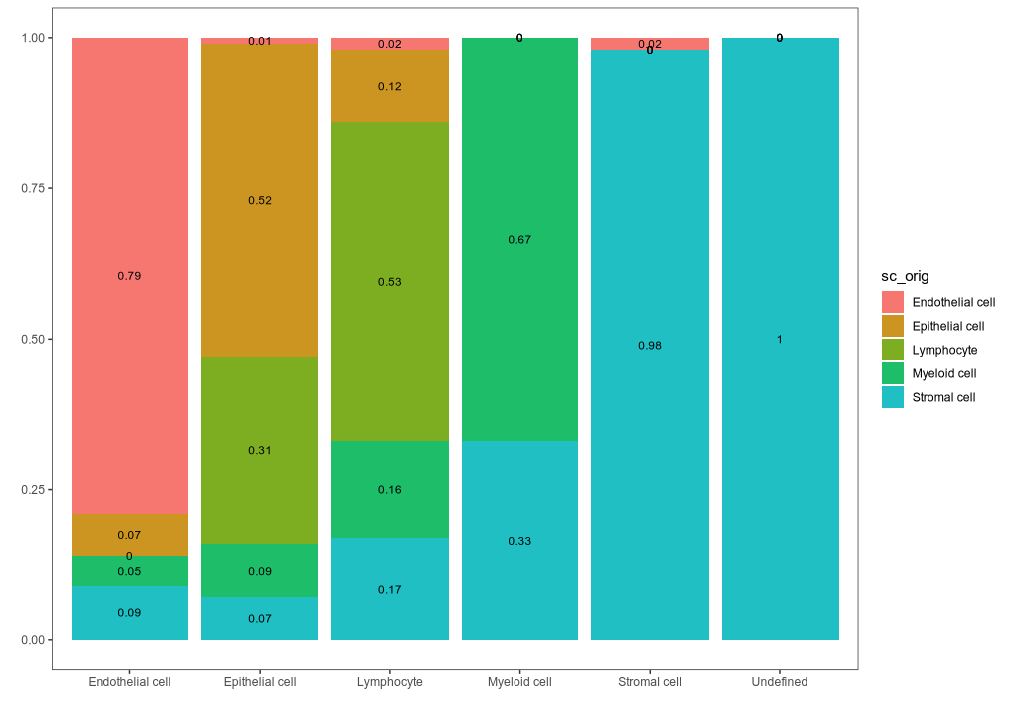
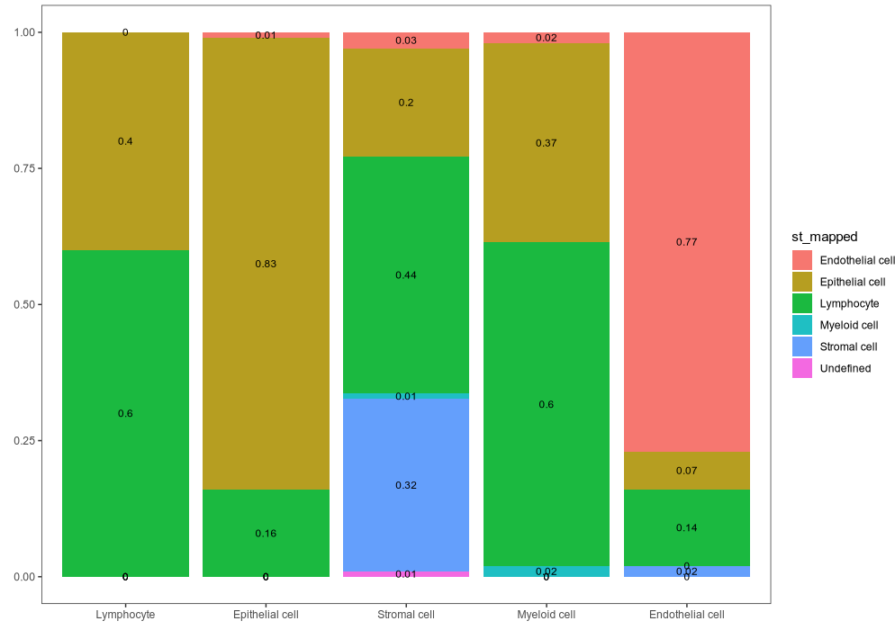
Application on Visium HD Dataset
ST Cell Type ➔ Single-cell Type Matching Prop
Single-cell Dataset Embedding Result_Original_Ident
Endothelial
Epithelial
Myeloid
Stromal
Undefined
Lymphocyte
Single-cell Type ➔ ST Cell Type Matching Prop
Single-cell Dataset Embedding Result_Mapped_Ident
Lymphocyte
Epithelial
Stromal
Myeloid
Endothelial

Slide 16
Problems
Too naïve?
- k-sensitive
- HVG-sensitive
- Single-cell/ST Identity mapping method…
Computation time
Just embedding(?) on same 2D space ➔ No correction/adjustment of gene expression
Evaluation metrics:
Original identity of single cell as ”ground truth”
➔ Original-Mapped identity confusion matrix, …

Slide 17
Suggestions
Without bin2cell:
- Pseudo-bulk approch for the spots
- 16-micron spots + Gaussian Filter
GPU - Parallelization?

